Slide 1
Workshop on Productivity and Innovation in Brazil
1-2 July 2015, Brasilia
Strengthening Innovation and Productivity in Brazil – What Policies for Innovation?
Dirk Pilat, Deputy Director
Directorate for Science, Technology and Innovation
dirk.pilat@oecd.org

Slide 2
Outline
Innovation, productivity and growth
Investing in innovation
Innovation policies, including business-science relationships
Business dynamics, jobs and the role of experimentation
Skills, skills, skills
Conclusions and policy implications

Slide 3
1. Innovation is one of the main drivers of growth and productivity …
Figure 1. Contributions to GDP growth
Total economy, annual percentage point contribution, 1995-2013
Innovation key driver of growth, through:
Technology embodied in fixed capital, e.g. ICT
Investment in knowledge-based capital (later slides)
Productivity growth due to innovation (MFP)
Creative destruction and business dynamism (later slides)
Source: OECD Productivity Database, January 2015, and OECD (2015a), OECD Compendium of Productivity Indicators, 2015.

Slide 4
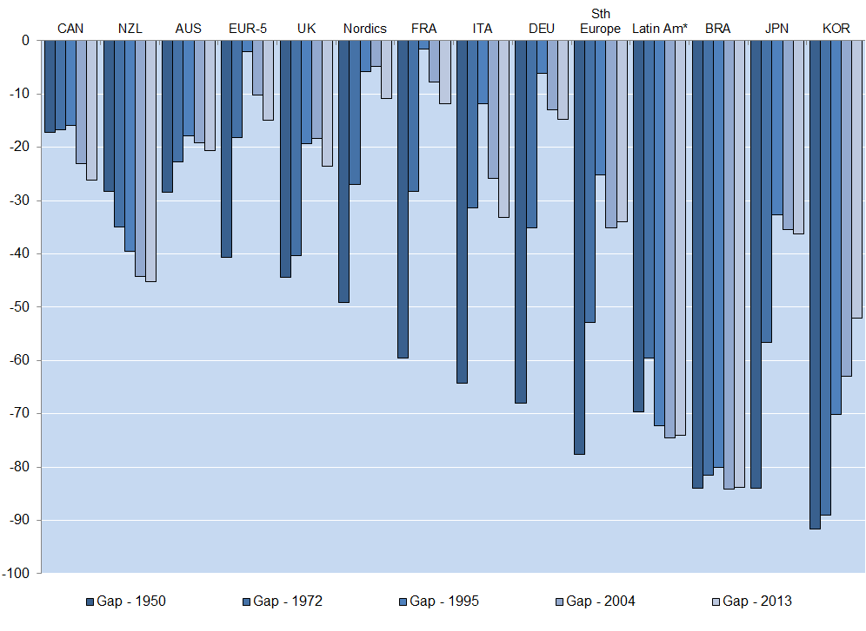
… but progress in Brazil has been limited over the past decades
Per cent gap in GDP per hour worked with the United States
Productivity growth in Brazil has disappointed,
given the large scope for catch-up …
Source: Conference Board Total Economy Database

Slide 5
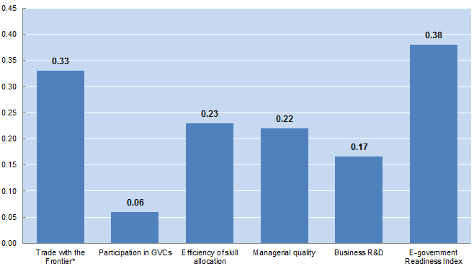
Learning from the global frontier is linked to several factors
Source: Saia, Andrews and Albrizio (2015) % difference in frontier spillover effect between maximum and minimum value of each structural variable, assuming 2% MFP growth at the frontier
Notes:
Notes: Trade with the global frontier measures the intensity of trade with the productivity leader in each manufacturing industry and is based on OECD calculations using OECD, STAN database (Minimum: Austria, Maximum: Canada). GVC Participation is based on the measure in Figure 15 (Minimum: Canada, Maximum: Belgium). Efficiency of skill allocation (Minimum: Italy, Maximum: Belgium) and managerial quality (Minimum: Italy, Maximum: Finland) are sourced from Adalet McGowan and Andrews (2015a). Business R&D is defined as the ratio of business R&D expenditures to value added and sourced from OECD, Main Science and Technology Indicators (Minimum: Australia, Maximum: Sweden). E-government readiness index (Minimum: Greece, Maximum: the Netherlands) is from OECD, Internet Economy Outlook 2012.

Slide 6
2. A growing share of business investment is related to innovation …
Business investment in KBC and tangible assets in the United States (% GDP, 1972-2011)
Source: Corrado et al. (2012).

Slide 7


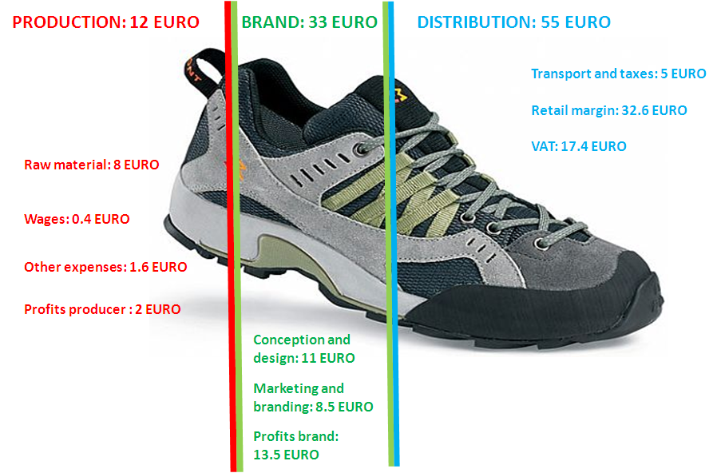



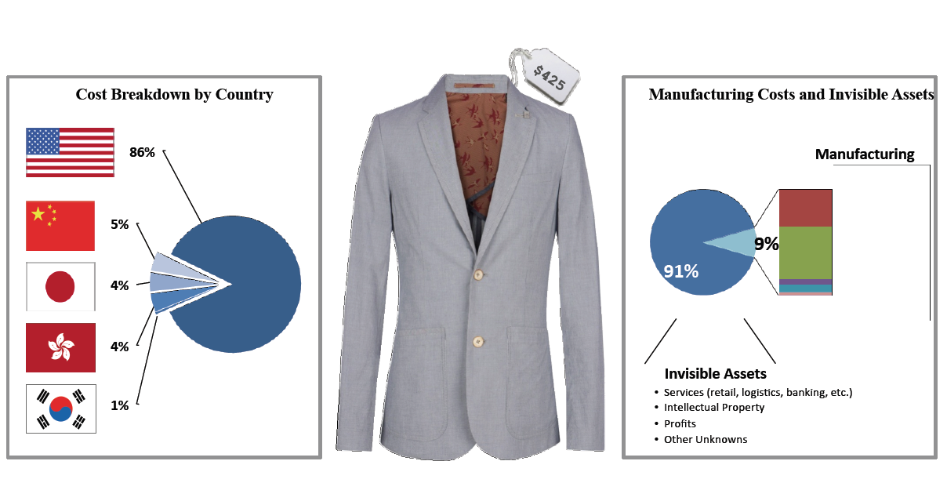
… which is increasingly central to value creation and product differentiation in global markets
SPORT SHOES: 100 EURO (final retail price)
Source: Trudo Dejonghe (Lessius)
Source: IMD (2000) Innovation and Renovation: The Nespresso Story, IMD046, 03/2003. © Nespresso
A SUIT… MADE IN CHINA, SOLD IN UNITED STATES
Source: Fung Global Institute
© General Motors, Chevy Volt

Slide 8
Sound framework policies are associated with investment in innovation …

Slide 9
… but resources in some countries don’t flow to the most innovative firms …
Change in capital stock associated with a 10% change in patent stock (2003-2010)
Source: Andrews, Criscuolo, and Menon (2014).

Slide 10
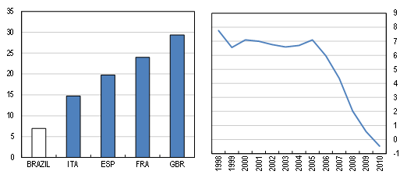
… including in Brazil, where the most productive firms in manufacturing don’t have a very large market share
Allocative efficiency in manufacturing, Brazil in international comparison and Brazil’s evolution over time
Note: The graphs measure the extent to which firms with greater efficiency have a greater market share. If there were no systematic relationship between productivity and the size of firms, the covariance term would be zero; the higher it is, the larger the market share held by more productive firms
Source: OECD calculations based on Arnold, Nicoletti and Scarpetta (2008), Gomes and Ribeiro (2015).

Slide 11
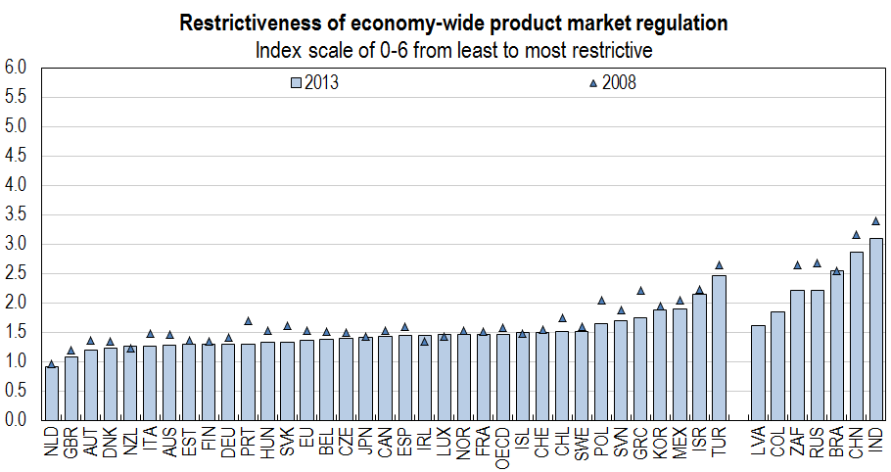
Opening up for competition could help - product market regulations in Brazil are still tight
Source: OECD (2015), Economic Policy Reforms: Going for Growth

Slide 12
Investment in innovation: key policy issues
Business investment in innovation is not just technology and R&D – complementarities and policies affecting other assets are important, e.g. data, design, management, organisational capital, skills, …
As these new areas of investment grow in importance, so do the policies affecting them – e.g. is Brazil’s IPR system fit for 21st century innovation?
In an innovative economy, resources need to flow to more innovative and productive firms – framework conditions, such as competition, are key for this to happen.

Slide 13
3. The specific mix of policies to support business innovation matters, …
Direct funding of business R&D and R&D tax incentives, as a percentage of GDP, 2012
Source: OECD R&D Tax Incentive Indicators, www.oecd.org/sti/rd-tax-stats.htm

Slide 14
… including how they are designed and who benefits
Implied tax subsidy on R&D, by firm size and profit scenario, 2013
Source: OECD R&D Tax Incentives Indicators; based on the 2013 OECD-NESTI data collection on tax incentives support for R&D expenditures http://www.oecd.org/sti/rd-tax-stats.htm).

Slide 15
Though policy needs to recognise that many innovative firms do not undertake R&D
Product Innovation, by R&D Status, 2008-10
Source: OECD, Science, Technology and Industry Scoreboard 2013, http://dx.doi.org/10.1787/888932892480

Slide 16
Well-designed direct support for innovation can work, but some lessons have been learned
Remove barriers before providing support - i.e. “don’t roll a ball up a hill”
Clarity in objective(s) – such that success and failure can be assessed in a non-discretionary manner
Evaluate (preferably ex ante and ex post) – and incorporate evaluation in policy cycle
Learn from experimentation – learn and fail fast
Ensure public bears risk which is “proportionate” (enough to matter, not too much to lead to moral hazard)
Plan for exit – and make plan known in advance
Competition - keep the outsiders and the unborn in mind – resist political economy pressures

Slide 17
Innovation and research: key policy issues
Many countries emphasize (R&D) tax incentives to support business innovation, but these have several drawbacks in strengthening innovation – better design can help reduce some of these drawbacks
Well-designed and competitive direct support for innovation, e.g. Fraunhofer-type Institutes, accelerators, support for university-industry relationships, etc., may be better suited to building innovation capabilities, including for firms that do not undertake R&D.
A good balance between direct and indirect support is needed.

Slide 18
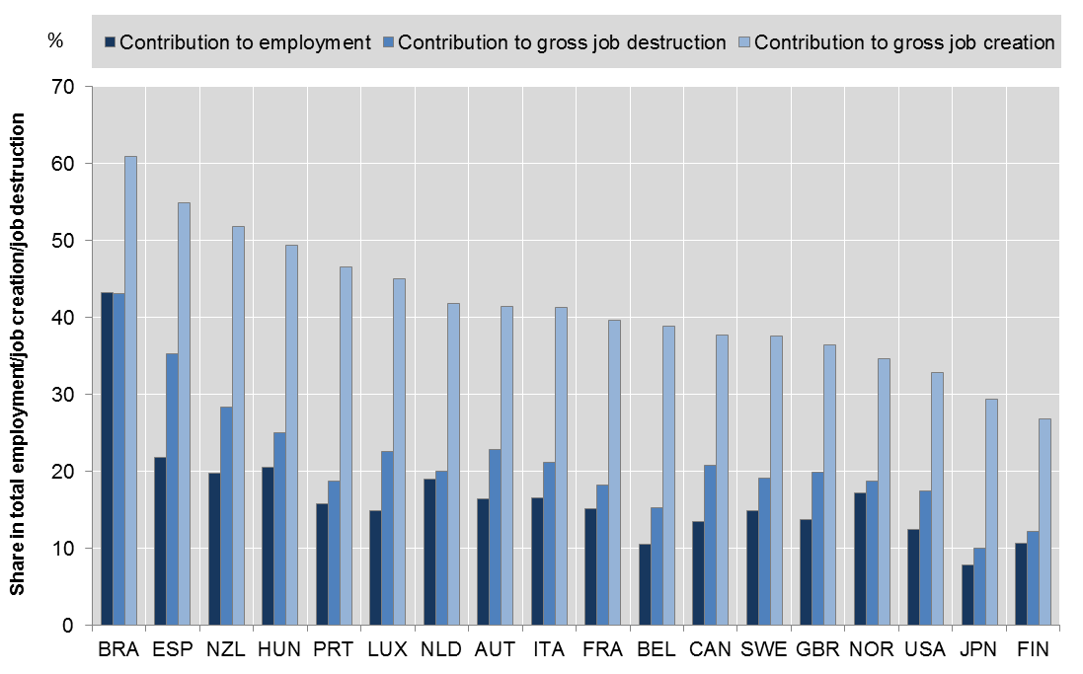
4. Young firms can create new opportunities …
Contributions of young firms to employment, job creation and job destruction, 2001-2011
Source: Criscuolo, Gal and Menon (2014), www.oecd.org/sti/dynemp.htm

Slide 19
… but scaling of young innovative firms is a challenge in many countries , including Brazil
Average size of start-ups and old firms, in persons employed, services sector
Source: Updated from Criscuolo, Gal and Menon (2014), www.oecd.org/sti/dynemp.htm

Slide 20
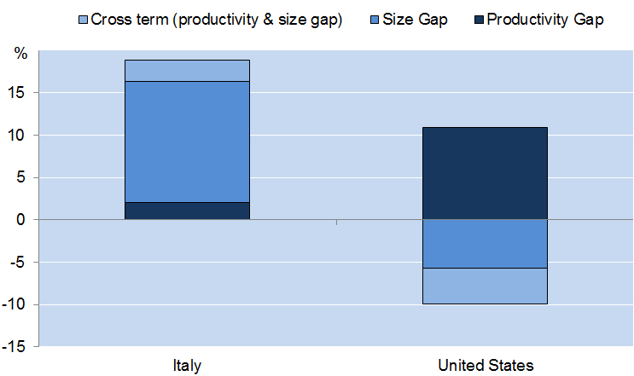
Reducing barriers to scaling increases the impact of firms at the national frontier on productivity
How much higher would overall manufacturing sector labour productivity
be if NF firms were as productive and large as GF firms?
NF firms in Italy have productivity levels close to the GF but they are relatively small
Source: Andrews, Criscuolo and Gal (2015), “Frontier firms, technology diffusion and public policy: micro evidence from OECD countries ” forthcoming OECD Working Paper.

Slide 21
Entrepreneurship and business dynamism – key policy issues
Enable experimentation and firm growth: Reduce barriers to entry (e.g. red tape), growth (e.g. size-specific regulations), and exit/failure of firms (e.g. penalising bankruptcy legislation, overly strict employment protection legislation).
Keep the unborn in mind: Policies in many countries often favour incumbents and MNEs (e.g. R&D tax credits, some environmental regulations, incumbent subsidies that delay exit).
Strengthen the innovation system for innovative firms, e.g. through enhanced access to (risk) capital, network development, mentoring of entrepreneurs, skills development, etc.
Reduce trade barriers and integrate in GVCs, so firms can scale more easily across borders.

Slide 22
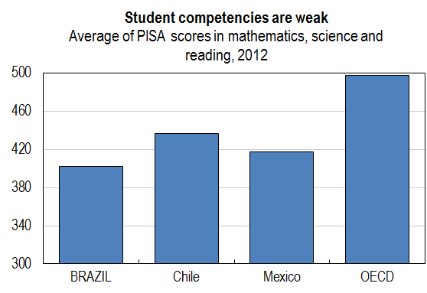
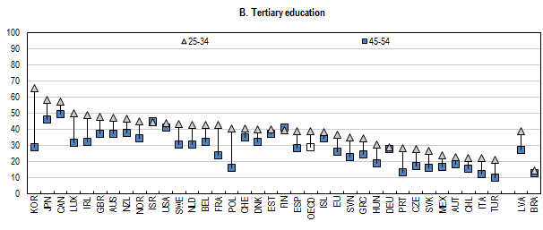
5. Raising human capital is key for innovation in Brazil
Percentage of population aged 25-34 and 45-54, 2012
Source: OECD (2015), Economic Policy Reforms: Going for Growth
Notes:
In 2011 the service content of total exports in Norway was 39.3%, below the OECD average of 54.3%, reflecting the significant share of oil exports, which have relatively low services content ( Figure 9).

Slide 23
Some conclusions
Brazil would benefit from a comprehensive approach to policies for innovation, including:
Improved policy frameworks for investment in innovation, notably policies that enable resource allocation to innovative firms – e.g. through stronger competition in product markets
A balanced set of innovation policies, based on best practice
Policies that enable entrepreneurship and strengthen business dynamism – allow new firms to fail or scale and unproductive firms to exit
Greater integration in global networks and value chains, to draw greater benefits from the global productivity frontier
A comprehensive strategy to increase education and skills
A strong focus on evaluation – to learn from experience
A more strategic approach to innovation – across the government – not just focused on innovation policies.
Notes:
In 2011 the service content of total exports in Norway was 39.3%, below the OECD average of 54.3%, reflecting the significant share of oil exports, which have relatively low services content ( Figure 9).

Slide 24


Thank you
Contact: Dirk.Pilat@oecd.org
Read more about our work:
Follow us 0n Twitter: @OECDinnovation
Website: www.oecd.org/sti
Newsletter: www.oecd.org/sti/news.htm

Slide 25
SPARES

Slide 26
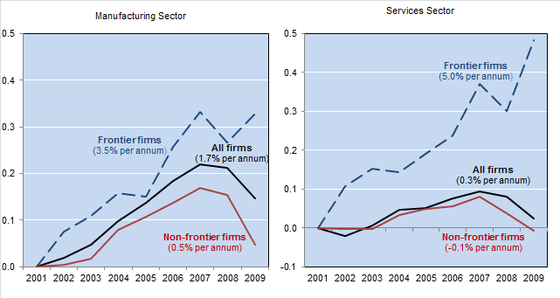
The global productivity frontier is still going strong, but diffusion to other firms is lagging
Solid growth at the global productivity frontier but spillovers disappoint
Labour productivity; index 2001=0
Source: Andrews, Criscuolo and Gal (2015), “Frontier firms, technology diffusion and public policy: micro evidence from OECD countries ” forthcoming OECD Working Paper.

Slide 27
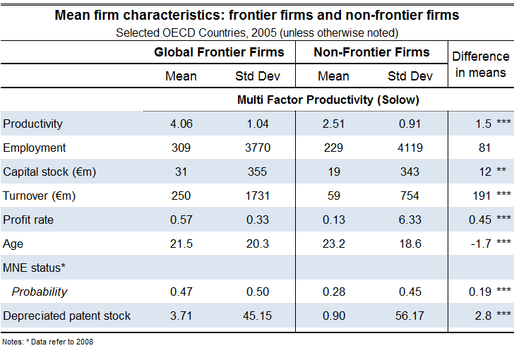
The globally most productive firms: who are they?
Note: “Frontier firms” corresponds to the average labour productivity of the 50 globally most productive firms in each 2
digit sector in ORBIS. “Non-frontier firms” is the average of all other firms.

Slide 28
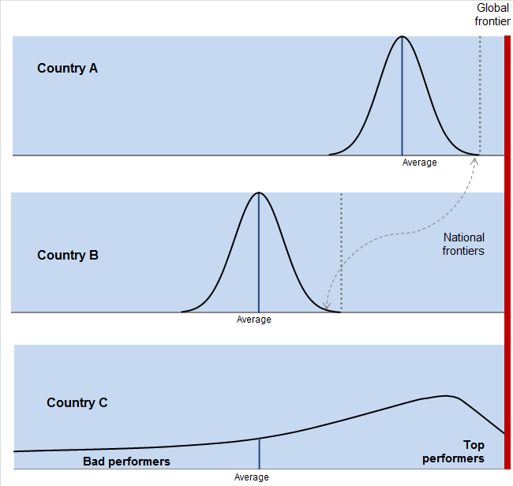
Innovation involves not only invention, but also adoption and diffusion
Global frontier
Adoption
convergence
National Frontier
Penetration
divergence
Laggards

Slide 29
… which are all affected by a range of factors

Slide 30
2. A growing share of investment is related to innovation …
Business investment in KBC and tangible assets
(as % of business sector value added, 2010)
Source: OECD calculations based on INTAN-Invest, Eurostat and multiple national sources.

Slide 31
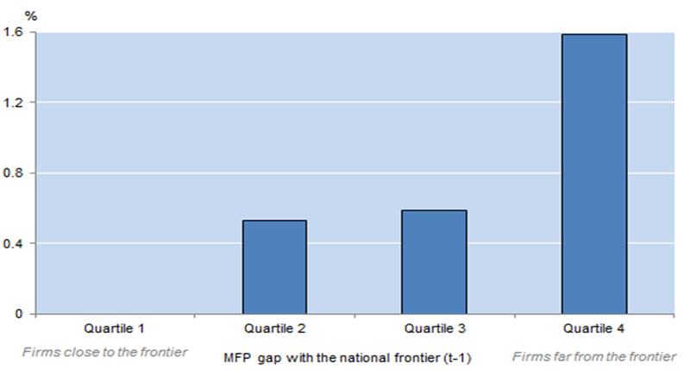
University – industry collaboration can facilitate catch-up of laggards to the national frontier
Impact of policy reforms on the MFP growth of laggard firms, 2005
Increasing Collaboration from low level in France to the OECD average
% difference between industries with high and low knowledge intensity
Source: Andrews, Criscuolo and Gal (2015), “Frontier firms, technology diffusion and public policy: micro evidence from OECD countries ” forthcoming OECD Working Paper.

Slide 32
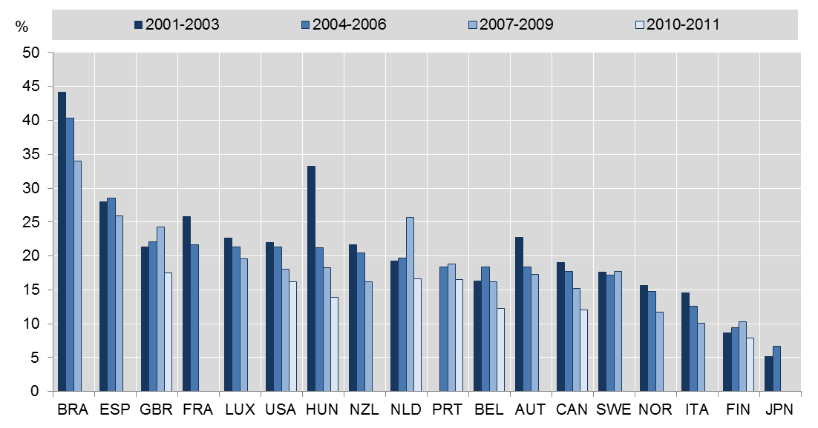
A concern: the share of start-ups is declining in many countries
Share of start-ups among all firms
Note: As a percent of all firms in the total private business sector. Startups are firms aged from 0 to 2. Data for Japan refers to establishment in the manufacturing sector.
Source: OECD, Dynemp Express – preliminary results.

Slide 33
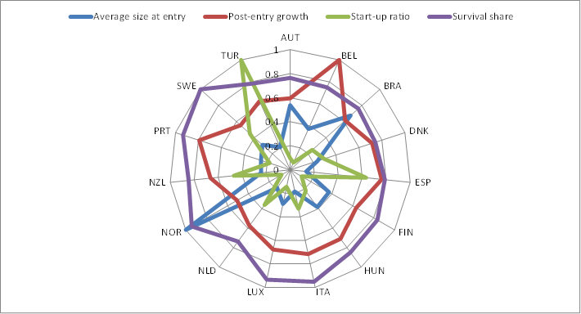
Business Dynamism and The Life Cycle of the Firm: Brazil Relative to Others
Preliminary Results for Brazil:
High Avg Size at Entry but Low Start-Up Rate
Note: the graph illustrates the four components of the growth decomposition normalized over the maximum value across all countries included in the sample.
Source: OECD DynEmp v.2 database. Data for some countries are still preliminary. Data for Brazil developed in co-operation with IPEA.

Slide 34
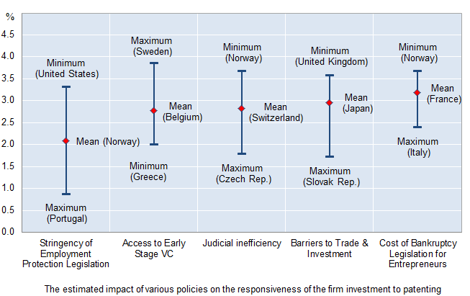
Access to Finance and other Policy Factors Encourage Scaling of Innovative Firms
Additional capital attracted by a firm that increases its patent stock by 10%, 2002-10
Source: Andrews, Criscuolo and Menon (2013).

Slide 35
Brazil is not heavily involved in global value chains
Foreign value added content of gross exports by country percent, 2008, 2009, and 2011 (right insert = time series for Brazil)
Source: OECD-WTO TiVA database, July 2015

Slide 36
Intra- and extra-regional foreign value added in GVCs – Average of TiVA reporters
5. South America is less integrated in global value chains than other regions …
Notes:
Notes: Figure hows the predicted average MFP growth (baseline based on actual GVC participation) and a counterfactual average MFP growth based on raising GVC participation in each country to the average GVC participation for the top 3 performers in each industry for any given year for the manufacturing sector. Industry level productivity is aggregated using country-specific industry value added shares. The estimates are calculated from a regression that controls for country*year and industry fixed effects and is based on a sample of 15 countries for the period 1990-2007.

Slide 37
… and Brazil’s main trading partners are outside the region
Brazil's exports to and imports from main partner countries
percent of total gross and value added exports and imports, 2011
Source: OECD-WTO Trade in Value Added database, July 2015
Notes:
Notes: Figure hows the predicted average MFP growth (baseline based on actual GVC participation) and a counterfactual average MFP growth based on raising GVC participation in each country to the average GVC participation for the top 3 performers in each industry for any given year for the manufacturing sector. Industry level productivity is aggregated using country-specific industry value added shares. The estimates are calculated from a regression that controls for country*year and industry fixed effects and is based on a sample of 15 countries for the period 1990-2007.

Slide 38
Services matter for trade, even in manufacturing …
Services value added embodied in manufacturing exports, by country
percent of total gross exports, 1995 and 2011
Source: OECD-WTO Trade in Value Added database, July 2015
Notes:
Although broadly stable over the last decades, the foreign content of Norwegian exports decreased by 2.7 percentage points between 1995 and 2011. The foreign content of Norway's exports stood at 17.2% in 2011, compared to 17.6% in 2009, but was higher than the pre-crisis level of 16.3% in 2008 (Figure 1). While relatively low compared to similar sized economies, this largely reflects Norway’s specialisation in oil.

Slide 39
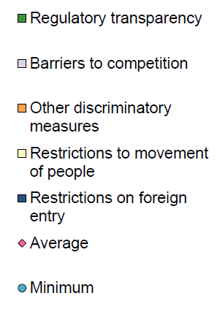
… although some barriers to services trade affect Brazil’s engagement
Services trade restrictiveness index (0- 1), Brazil
Source: OECD Services Trade Restrictiveness Index http://www.oecd.org/tad/services-trade/services-trade-restrictiveness-index.htm
Notes:
In 2011 the service content of total exports in Norway was 39.3%, below the OECD average of 54.3%, reflecting the significant share of oil exports, which have relatively low services content ( Figure 9).

